Slide 1
Creative Thinking
By Drew Boyd
Thanyaporn Phinthuphan
8 Jan 2020

Slide 2
Outline
Introduction
Individual creativity
Group creativity
Conclusion

Slide 3
Introduction
What is creative?
How does the brain work?
What is barriers?

Slide 4
What is creative?
creative thought have 3 criteria
new
useful
surprising

Slide 5
How does the brain work?
brain process called
Geneplore
=
Generation + Exploration
generates a concept when you force previously unrelated things together
explores the value of concept for some reason why that would be useful

Slide 6
What is the barriers?
constraints?

Slide 7

What is the barriers?
constraints
your brain works harder and smarter when given tight boundaries.
the more constrained you are, the more creative you'll be

Slide 8

What is the barriers?
constraints
your brain works harder and smarter when given tight boundaries
the more constrained you are, the more creative you'll be
fixedness
limits our ability to see the world differently
3 types: functional, structural, relational

Slide 9
Individual creativity
Methodology
(SIT)
Principle
(Function follow form)
5 Thinking techniques

Slide 10
SIT Methodology
SIT: Systematic Inventive Thinking
innovation follows a set of patterns that can be reapplied to any product
5 patterns

Slide 11
Function Follow Form Principle
starting with the solution and then work backwards to the problem
start with an existing situation → list all the components / attributes
apply one of the five thinking tools → virtual product
ask yourself 2 questions
  should we do it?
  can we do it?
adaptations step

Slide 12
Technique 1 : Subtraction
the elimination of an essential component of a product
list all the internal components
remove a component
ask yourself 2 questions

Slide 13
Technique 2 : Division
separate the product or its components and then rearranging them back into the product
3 types
divide functionally
divide physically
divide through preserving
cuts your biggest challenges down to size so you can see new innovative opportunities

Slide 14
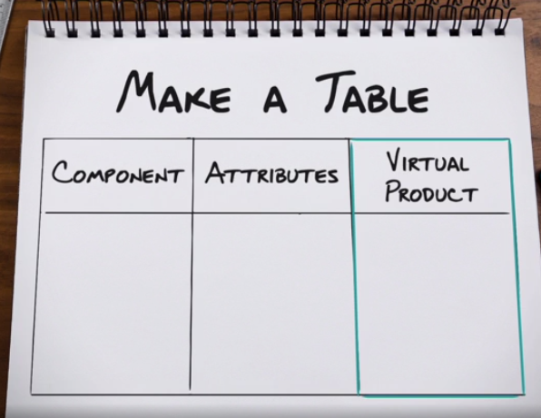
Technique 3 : Multiplication
copy an element already existing in a product but change it in some counterintuitive way

Slide 15
Technique 4 : Task Unification
assign additional tasks to an existing resource
3 general ways
an internal component takes the job of another internal component
an internal component takes the job of an external component
an external component takes the job of an internal component

Slide 16
Technique 5 : Attribute Dependency
one thing changes as another thing changes
make 2 lists
list attributes of the surrounding environment and people related as 1, 2, 3
list attributes of the product or service as A, B, C
randomly select one attribute from each list and create a simple phrase
As attribute ______ changes, so does attribute _______.

Slide 17
Group Creativity
Create team
Facilitate
Select ideas

Slide 18
Creativity dream team
Diversity → functional, gender, cultural

Slide 19
Facilitate group
decide on a workshop location
identify constraints
decide which of 5 techniques to apply
create a list of the components
work in smaller groups with different component
prevent bias with ideas

Slide 20
Select the best ideas
decide what qualifies as a great idea
put all your ideas in a standard format
individuals review lists of ideas
votes are tallied

Slide 21
Conclusion
SIT with Function follow form principle & 5 thinking techniques
Drew Boyd’s Pinterest for example (www.pinterest.com/drewboyd)
go out there and do it !

